Slide 1
CEIS 150 Final Project By Julan McFadden

Slide 2
Introduction
In this course CEIS 150 (Programing with Objects) courses I will Package all my projects into one powerful power point. my course projects allowed me the ability to practice and learn programming. This is a snapshot into my journey. Look at the information below and see my Highs & Lows my Failures & Successes. Come with me as I walk to the finish line to my future.

Slide 3
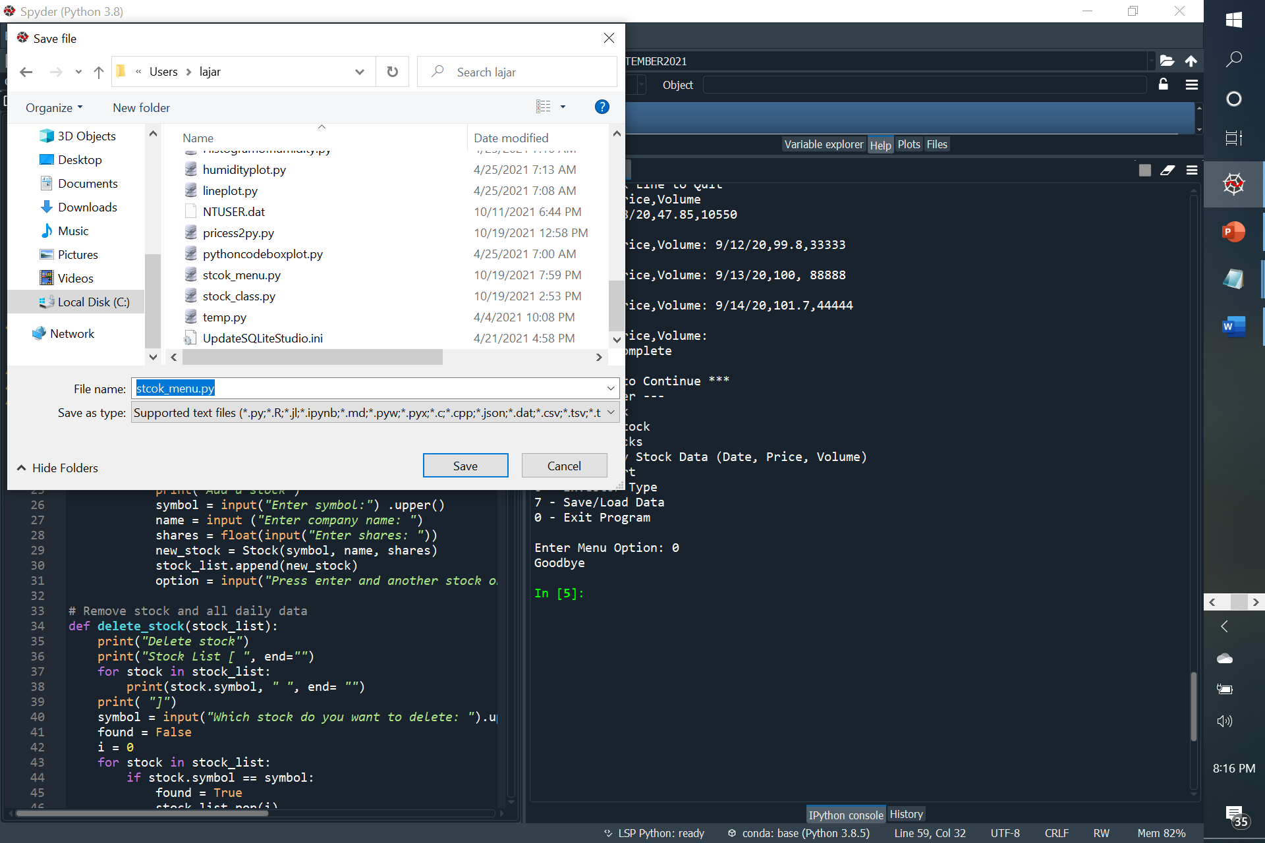
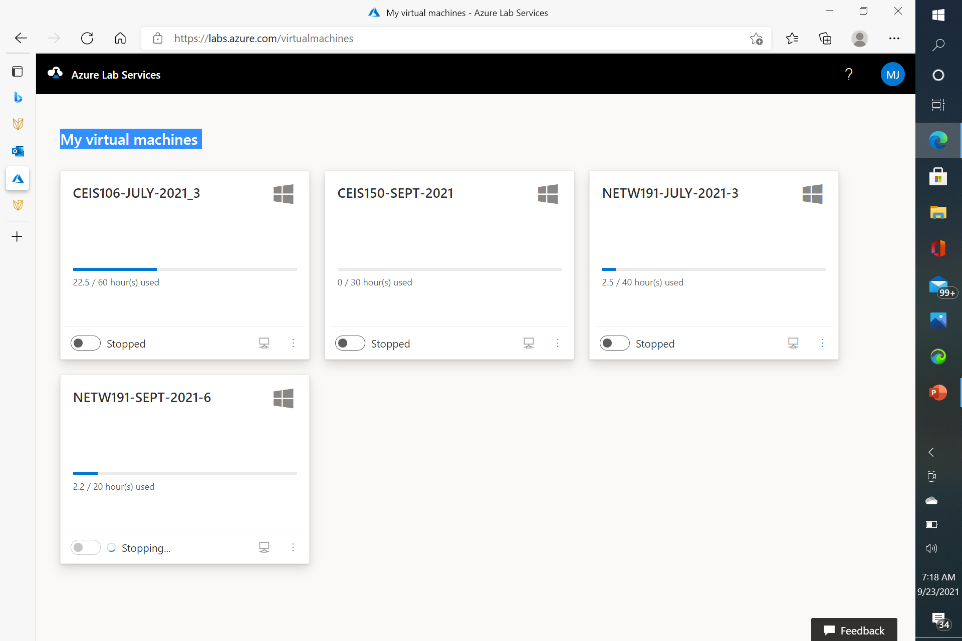
Project Modules Azure lab / File saving

Slide 4
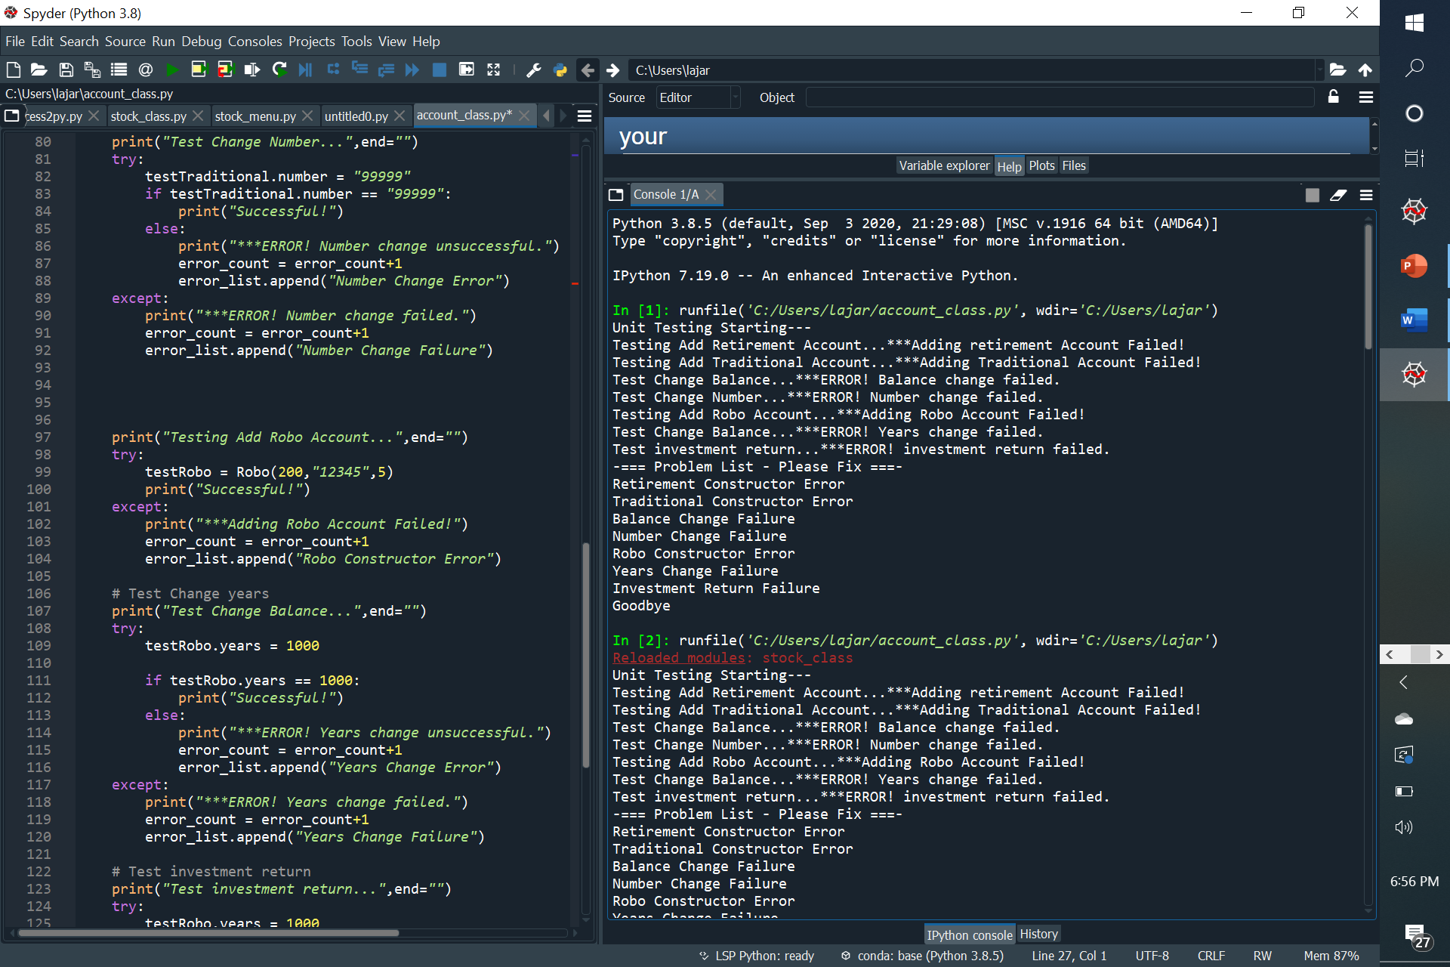
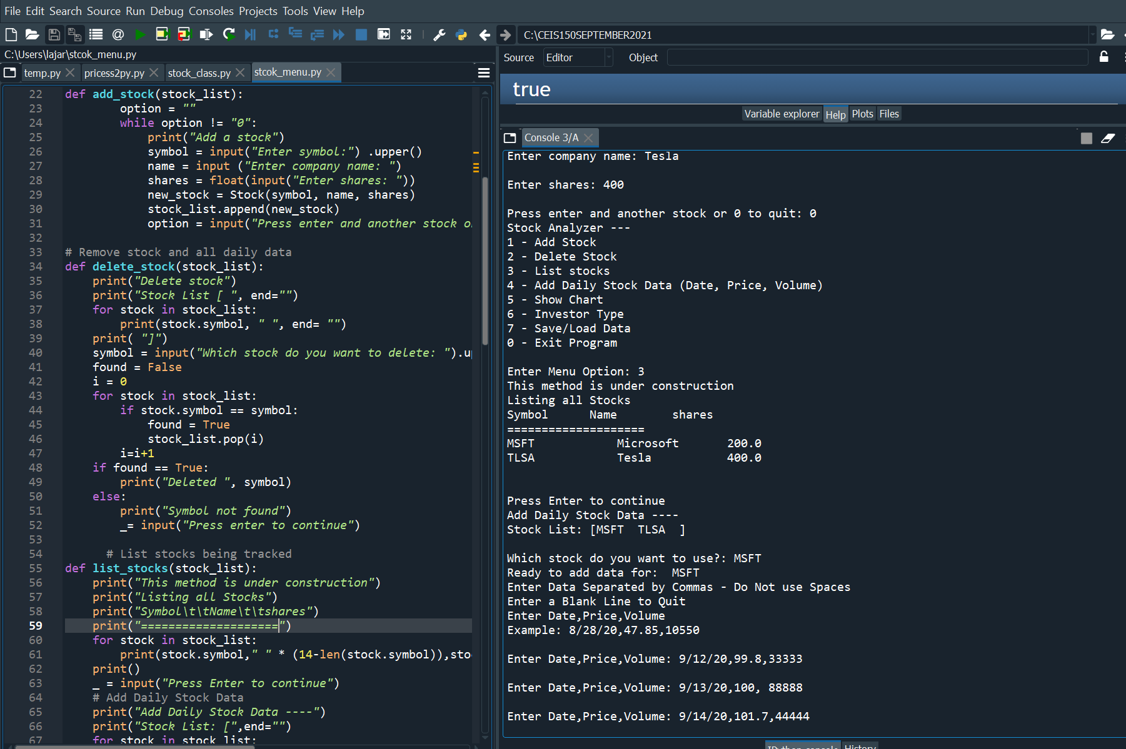
Project Modules Stock List / Testing

Slide 5
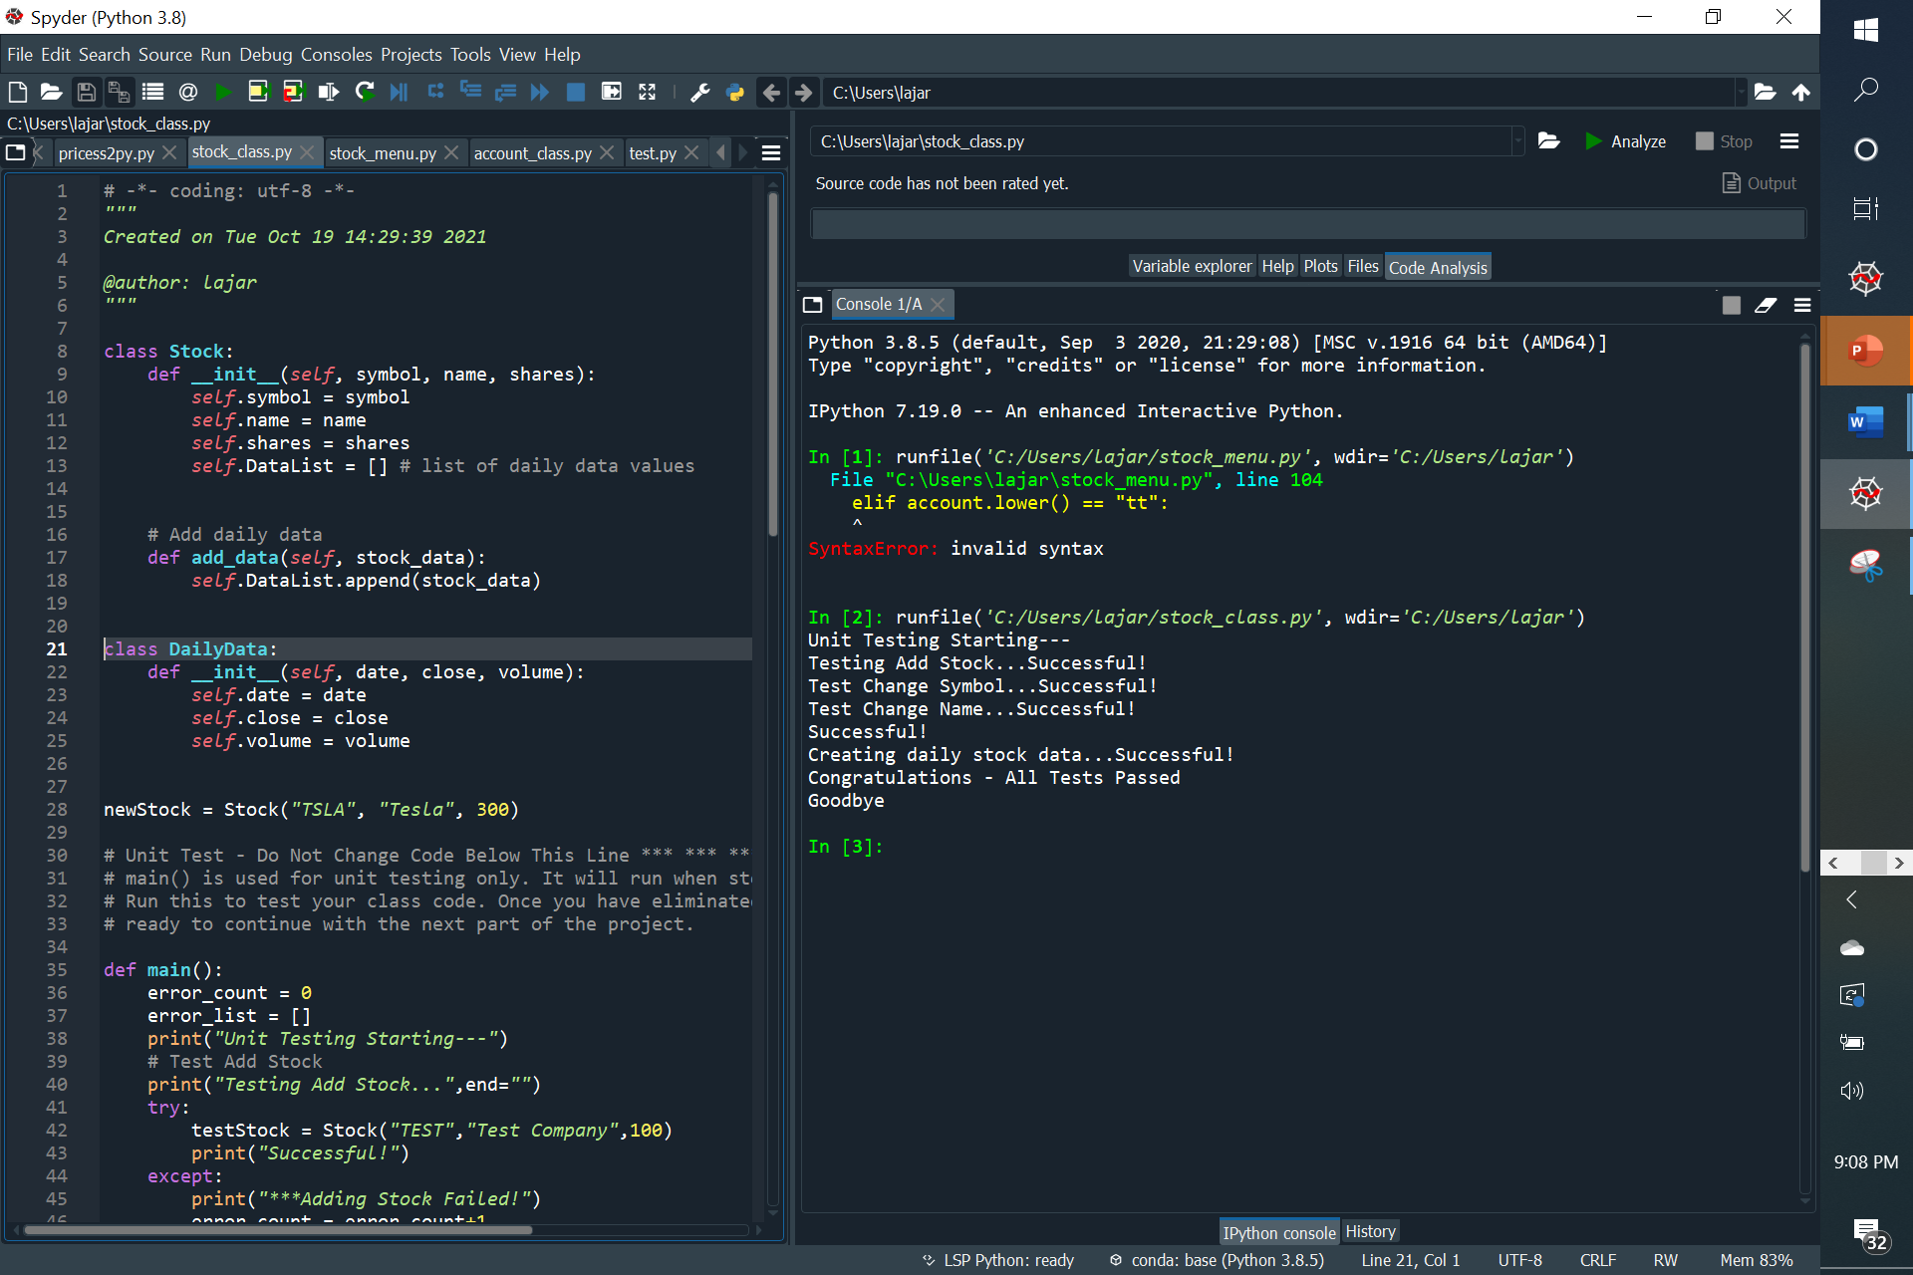
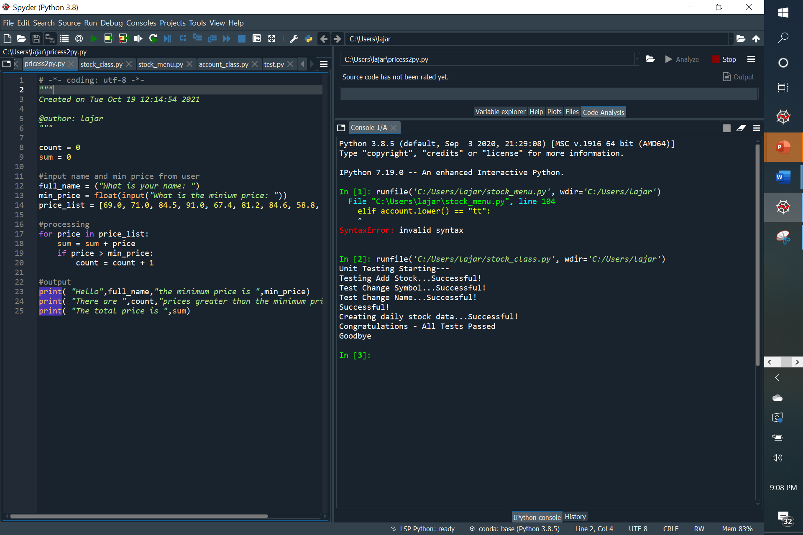
Project Modules Unit Testing

Slide 6
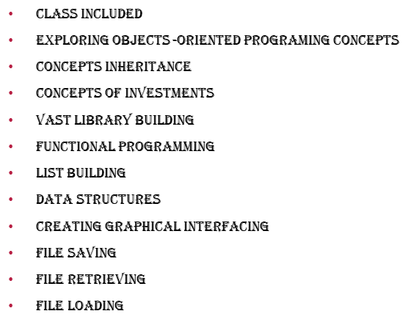

Summary of Modules

Slide 7
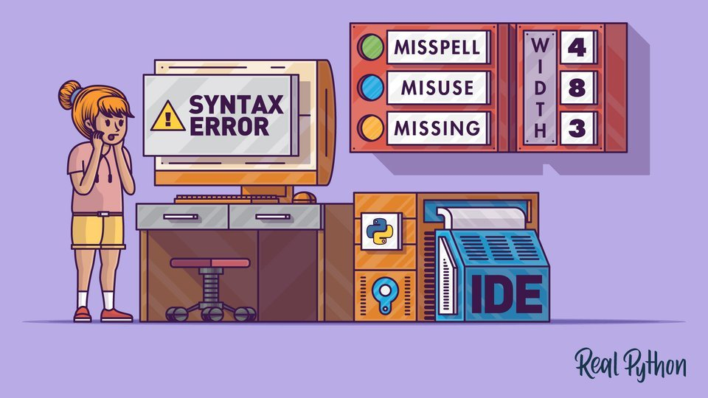
Challenges
Invalid Syntax in Python: Common Reasons for SyntaxError – Real Python

Slide 8
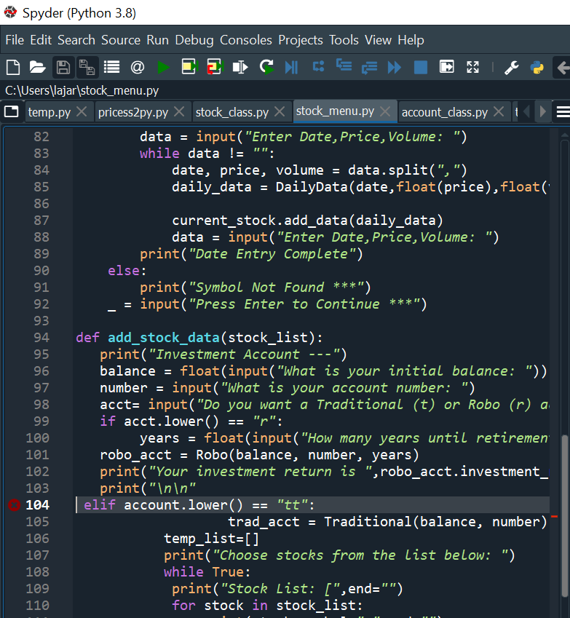
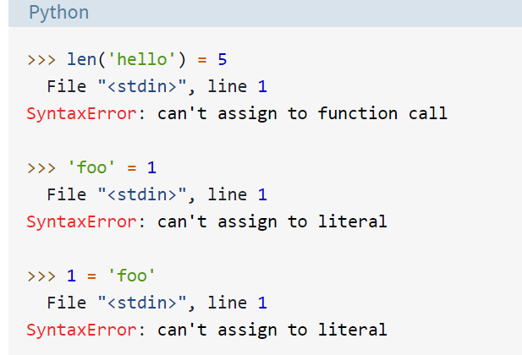

Misusing the Assignment Operator (=)

Slide 9
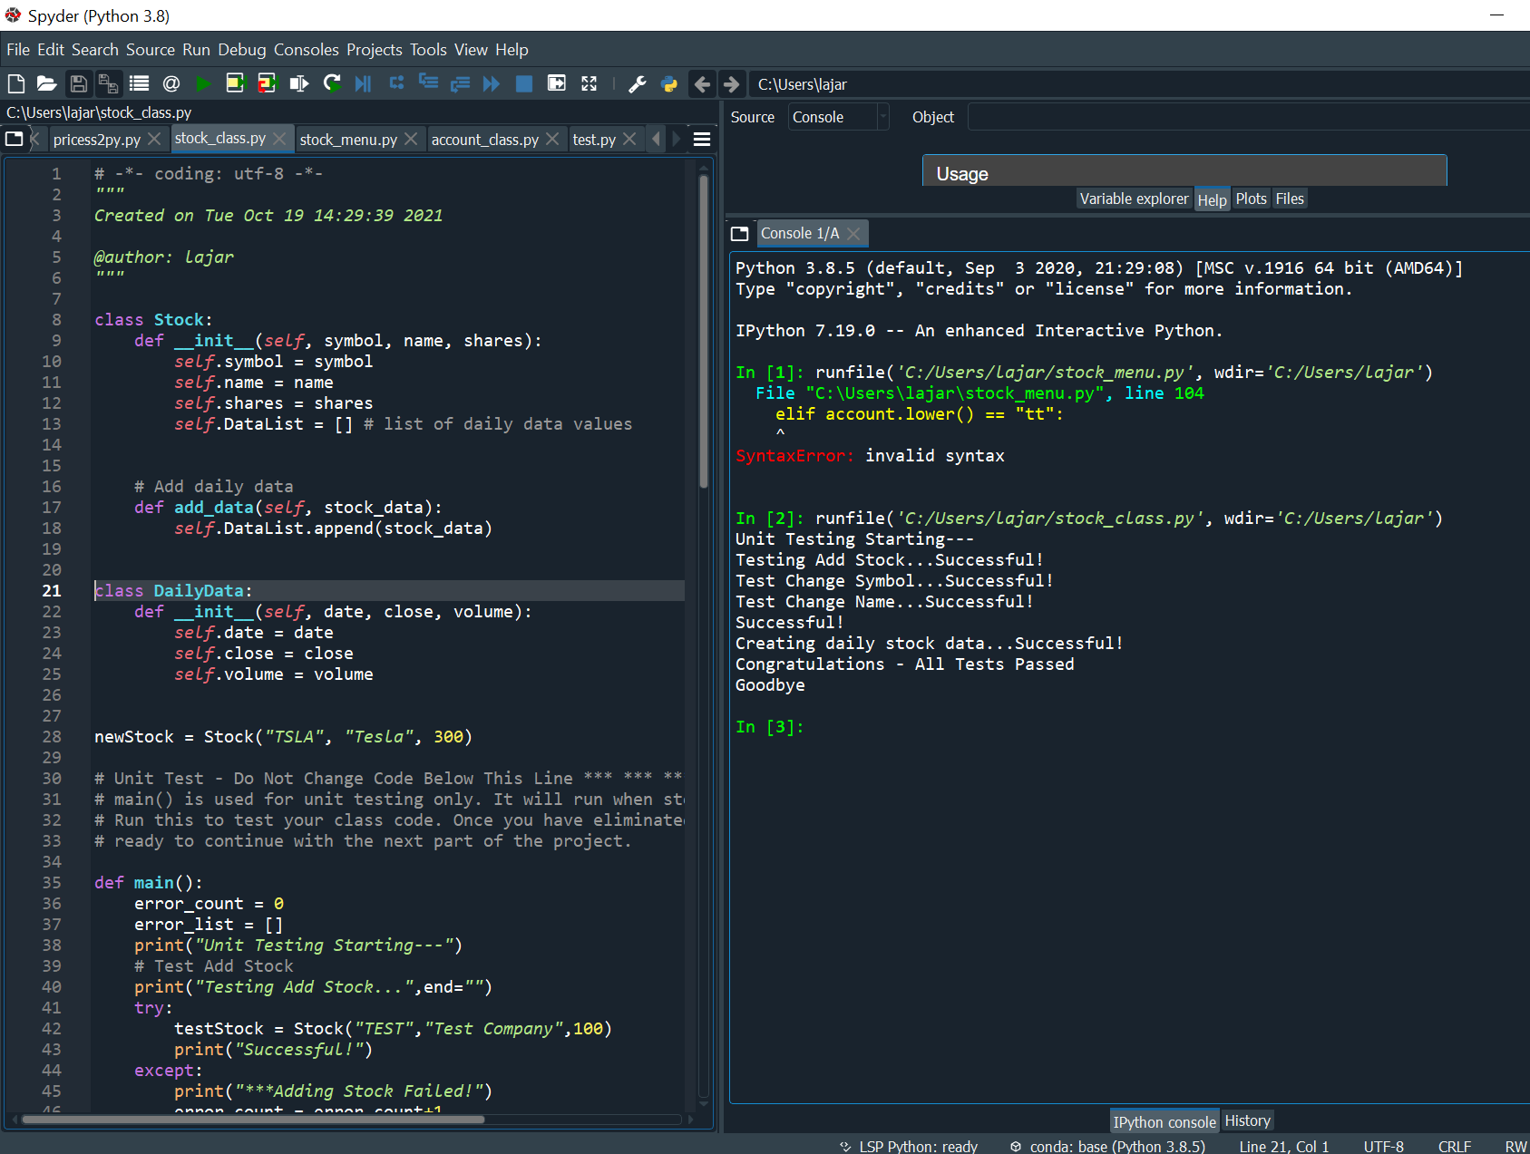
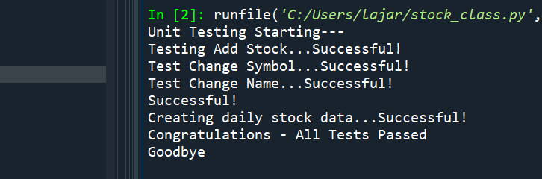
Successful Results

Slide 10

Career Skills Developed
Patients
Data Analytics
programing Concepts
Concepts of Inheritance & Investments
Data Structures
Creating Graphical Interfacing
File Saving, File Retrieving &File Loading

Slide 11
Conclusion

